Slide 1
Time Series Analysis and Forecasting
Ch1. Getting started
Adopted from http://OTexts.org/fpp3/

Slide 2
Outline
What can we forecast?
Time series data and random futures
Some case studies

Slide 3
What can we forecast?
Forecasting is about predicting the future as accurately as possible, given all of the information available, including historical data and knowledge of any future events that might impact the forecasts.

Slide 4

Forecasting is diﬃcult
Commonwealth plans to drift back to surplus show the triumph of experience over hope
Actual and forecast Commonwealth underlying cash balance
per cent of GDP
1
Forecast made in
2011 2012 2013 2014
0
2015
2016 2017
-1
-2
-3
Actual
-4
-5
2009 2010 2011 2012 2013 2014 2015 2016 2017 2018 2019 2020
Financial year ended
3
Notes:
Forecasts that aren’t forecasts

Slide 5
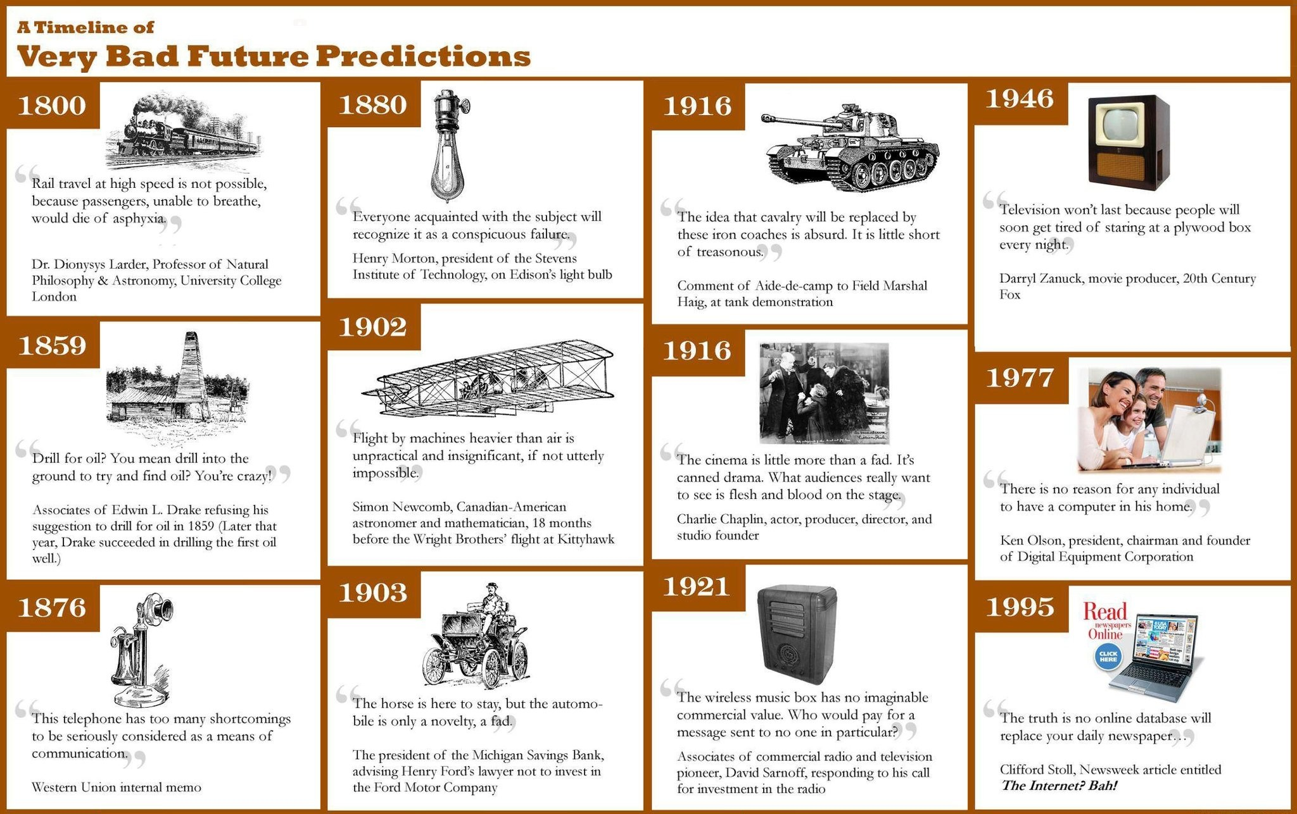
Forecasting is diﬃcult

Slide 6
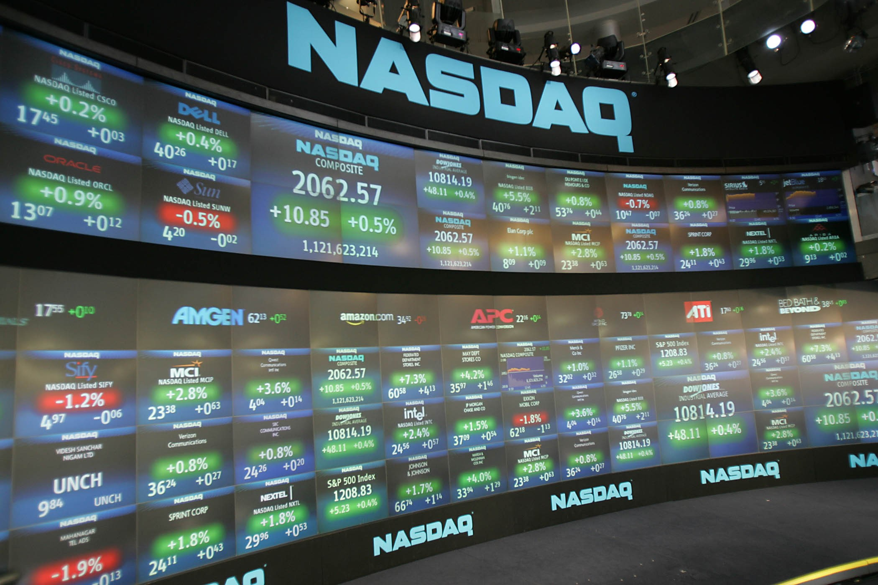
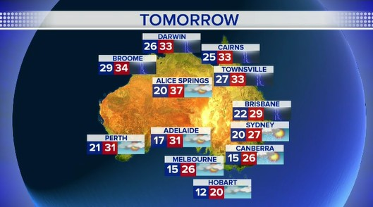



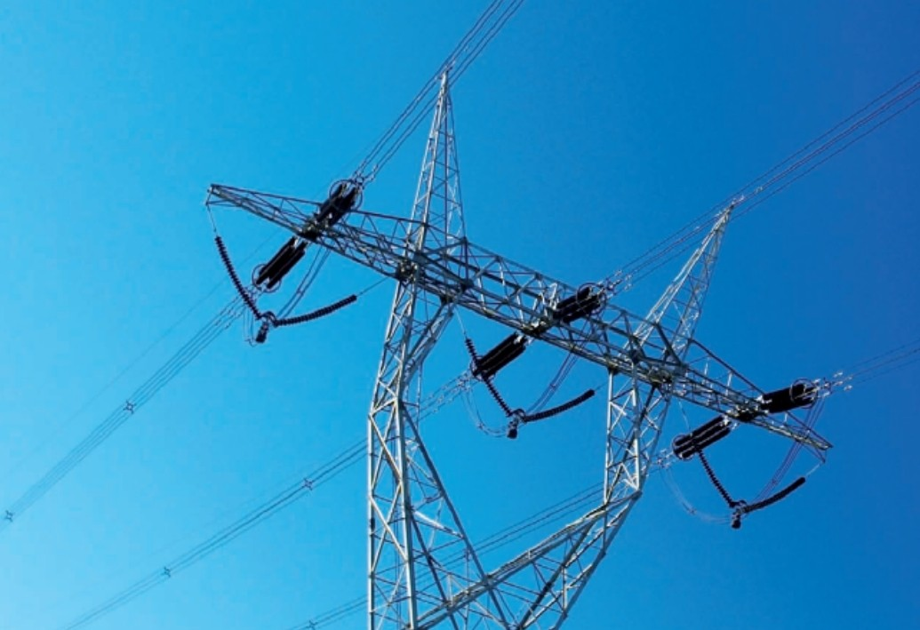


What can we forecast?

Slide 7
Which is easiest to forecast?
Daily electricity demand in 3 days time
Time of sunrise this day next year
Google stock price tomorrow
Google stock price in 6 months time
Maximum temperature tomorrow
Exchange rate of $US/AUS next week
Total sales of drugs in Australian pharmacies next month
Timing of next Halley’s comet appearance

Slide 8
Which is easiest to forecast?
Time of sunrise this day next year
Timing of next Halley’s comet appearance
Maximum temperature tomorrow
Daily electricity demand in 3 days time
Total sales of drugs in Australian pharmacies next month
Google stock price tomorrow
Exchange rate of $US/AUS next week
Google stock price in 6 months time
how do we measure “easiest”?
what makes something easy/difficult to forecast?

Slide 9
Forecastability factors
Something is easier to forecast if:
We have a good understanding of the factors that contribute to it
There is lots of data available;
The future is somewhat similar to the past
The forecasts cannot affect the thing we are trying to forecast.
There is relatively low natural/unexplainable random variation.

Slide 10
Time series data and random futures

Slide 11
Time series data
600
500
400
300
200
.
1960
1970
1980
1990
2000
2010
Time
Four-yearly Olympic winning times
Annual Google profits
Quarterly Australian beer production
Monthly rainfall
Weekly retail sales
Daily IBM stock prices
Hourly electricity demand
5-minute freeway traffic counts
Time-stamped stock transaction data

Slide 12
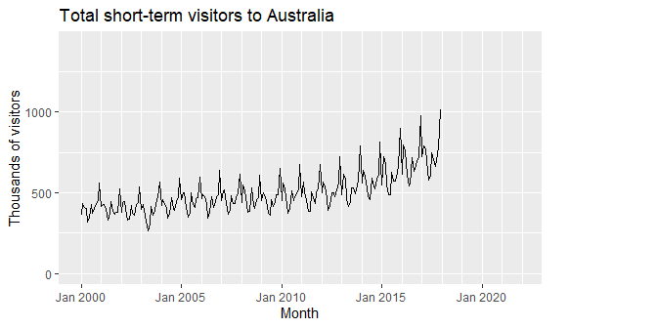
Random futures
A forecast is an estimate of the probabilities of possible futures.

Slide 13
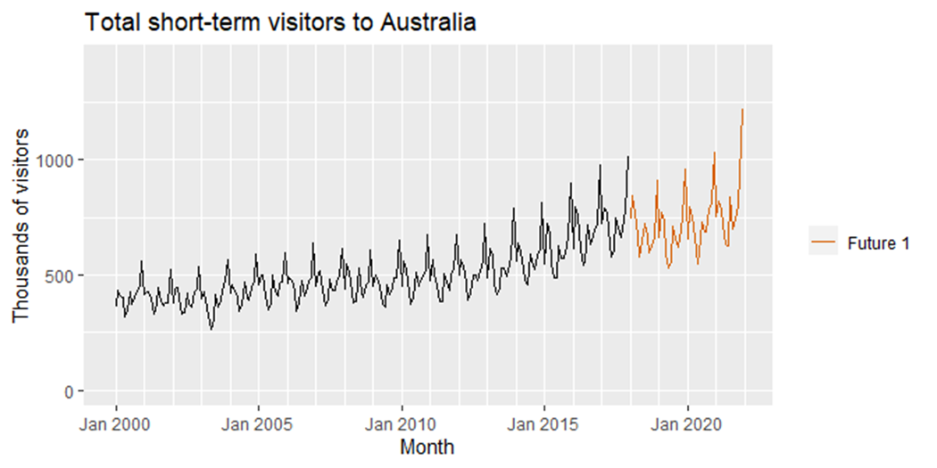
Random futures
A forecast is an estimate of the probabilities of possible futures.
Simulated futures from an ETS model

Slide 14
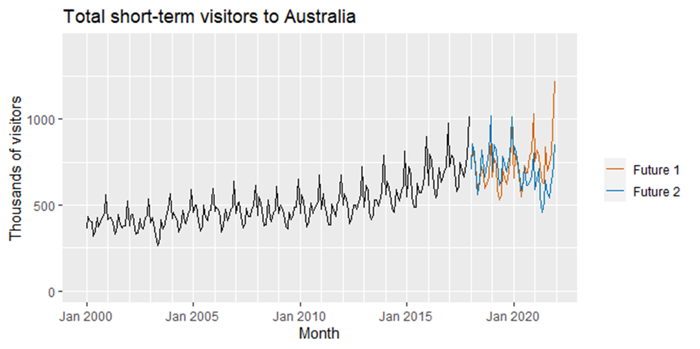
Random futures
A forecast is an estimate of the probabilities of possible futures.

Slide 15
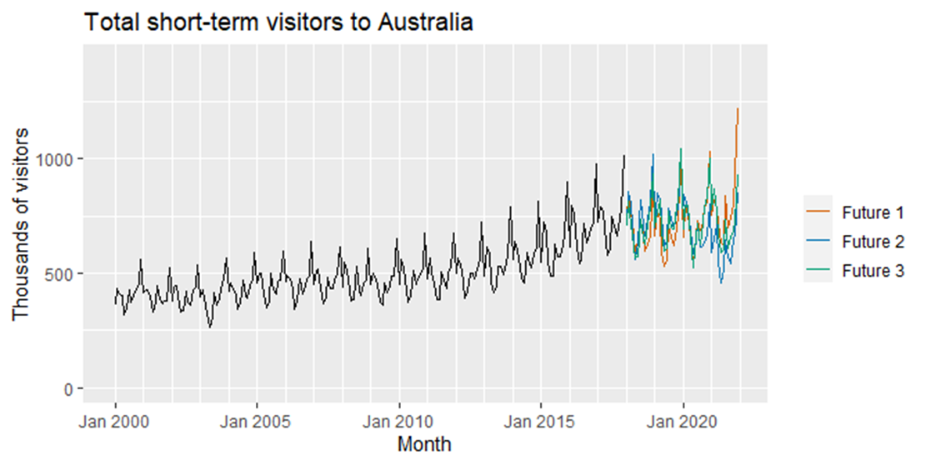
Random futures
A forecast is an estimate of the probabilities of possible futures.

Slide 16
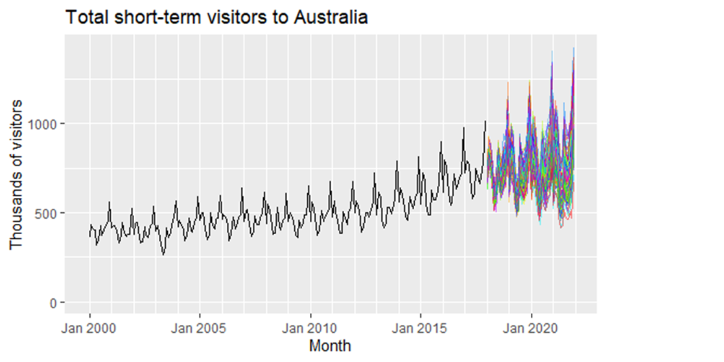
Random futures
A forecast is an estimate of the probabilities of possible futures.

Slide 17
Random futures
A forecast is an estimate of the probabilities of possible futures.

Slide 18
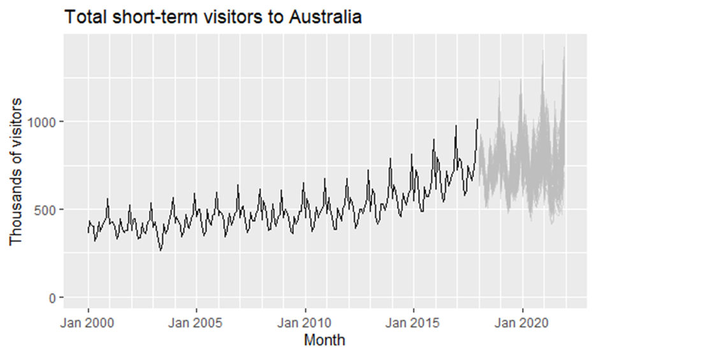
Random futures
A forecast is an estimate of the probabilities of possible futures.

Slide 19
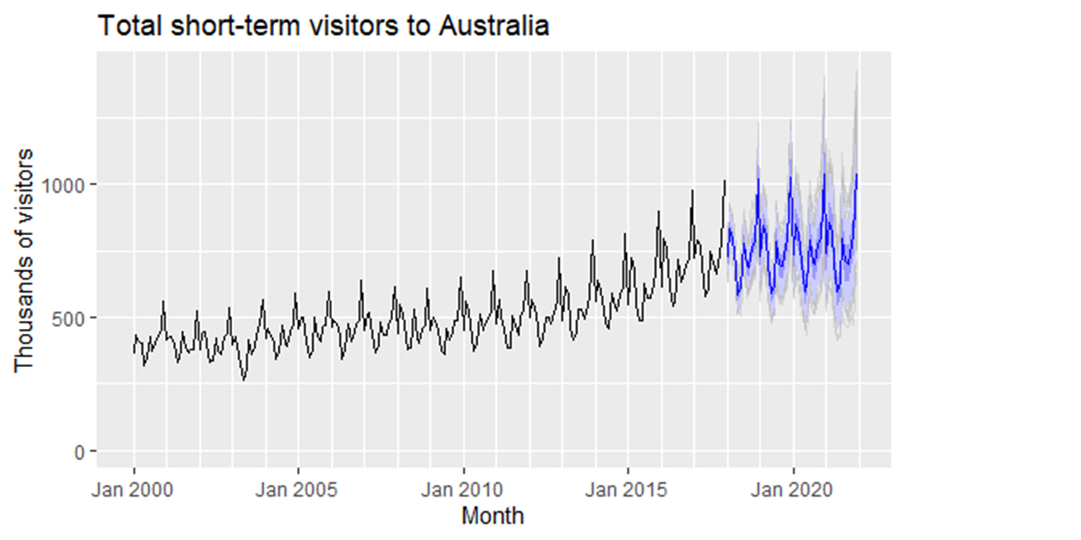
Random futures
A forecast is an estimate of the probabilities of possible futures.

Slide 20
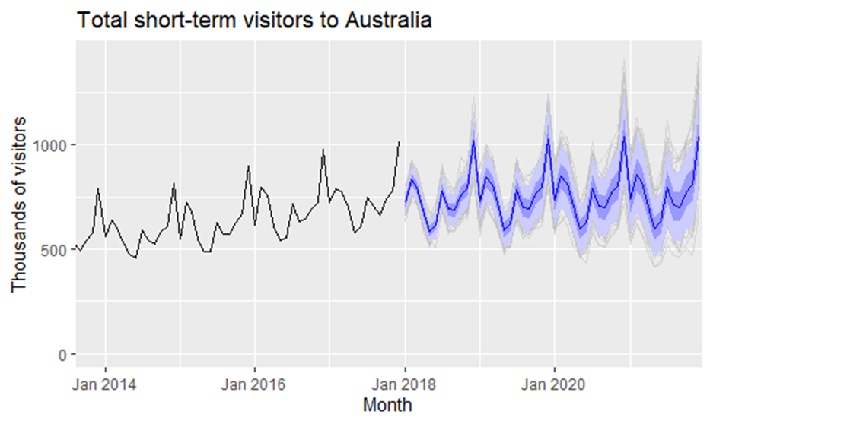
Random futures
A forecast is an estimate of the probabilities of possible futures.

Slide 21
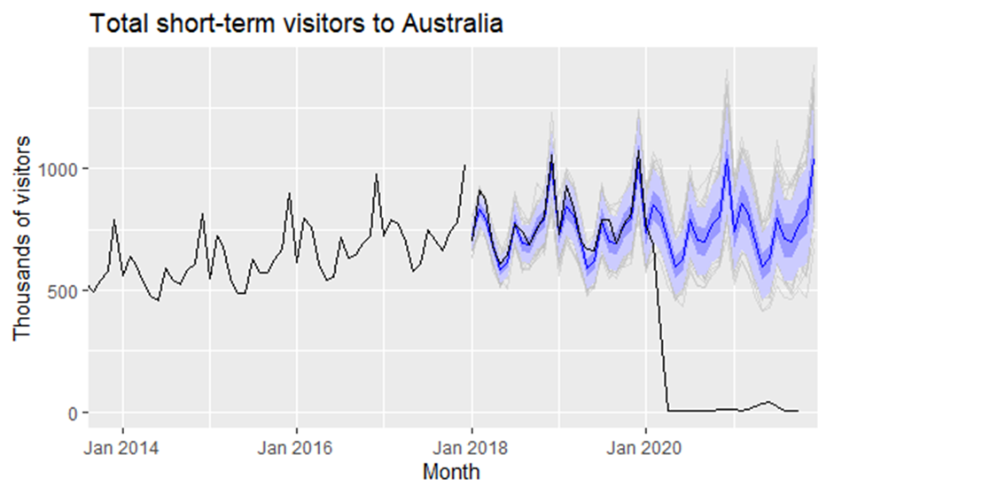
Random futures
A forecast is an estimate of the probabilities of possible futures.
“He who sees the past as surprise-free is bound to have a future full of surprises.” (Amos Tversky)

Slide 22
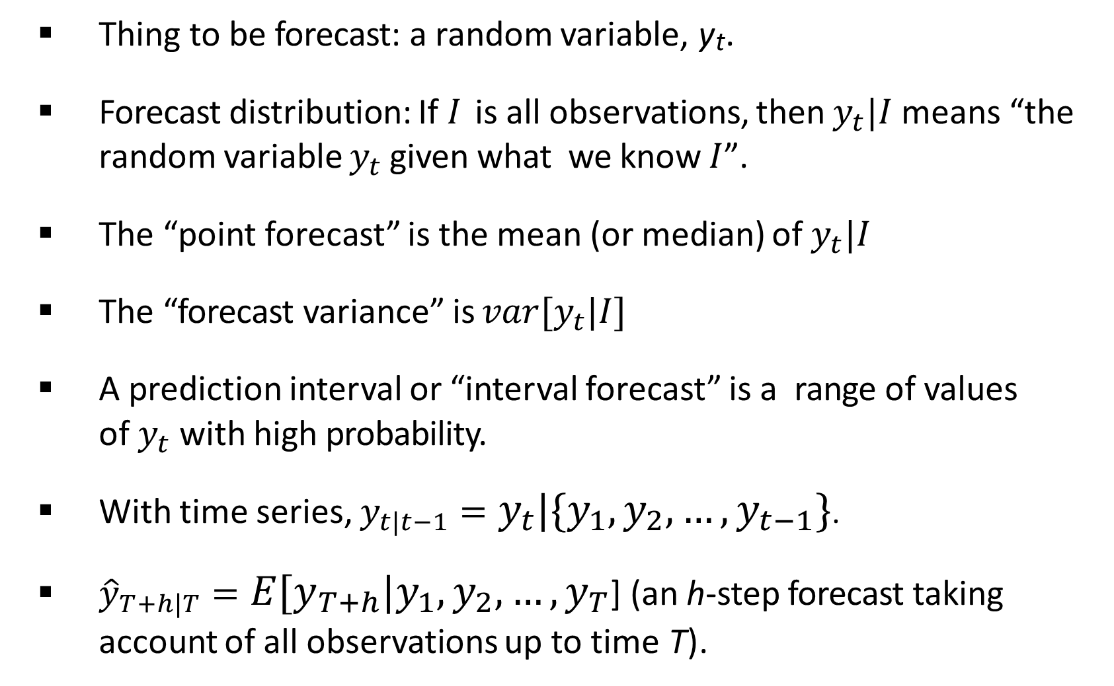
Statistical forecasting
Thing to be forecast: a random variable, y_{t}.
Forecast distribution: If $I$ is all observations, then $y_{t}|I$means “the random variable $y_{t}$ given what we know $I$”.
The “point forecast” is the mean (or median) of $y_{t}|I$
The “forecast variance” is ${var[y}_{t}|I]$
A prediction interval or “interval forecast” is a range of values of $y_{t}$with high probability.
With time series, $y_{t|t−1}=y_{t}|\{y_{1},y_{2},…,y_{t−1}\}$.
${\hat{y}}_{T+h|T}={E[y}_{T+h}|y_{1},y_{2},…,y_{T}$] (an h-step forecast taking account of all observations up to time T).
36

Slide 23
Some case studies

Slide 24

CASE STUDY 1: Paperware company
Problem: Want forecasts of each of hundreds of items. Series can be stationary, trended or seasonal. They currently have a large forecasting program written in-house but it doesn’t seem to produce sensible forecasts. They want to know what is wrong and ﬁx it.
Additional information
Program written in COBOL making numerical calculations limited. It is not possible to do any optimization.
Their programmer has little experience in numerical computing.
They employ no statisticians and want the program to produce forecasts automatically.

Slide 25
CASE STUDY 1: Paperware company
Methods used
12-month average
6 month average
straight line regression over last 12 months
straight line regression over last 6 months
average slope between last year’s and this year’s values. (Equivalent to differencing at lag 12 and taking mean.)
Same as previous except over 6 months.
Poorly documented forecast

Slide 26
CASE STUDY 2: PBS
The Pharmaceutical Benefits Scheme (PBS) is the Australian government drugs subsidy scheme.
Many drugs bought from pharmacies are subsidised to allow more equitable access to modern drugs.
The cost to government is determined by the number and types of drugs purchased. Currently nearly 1% of GDP.
The total cost is budgeted based on forecasts of drug usage.

Slide 27
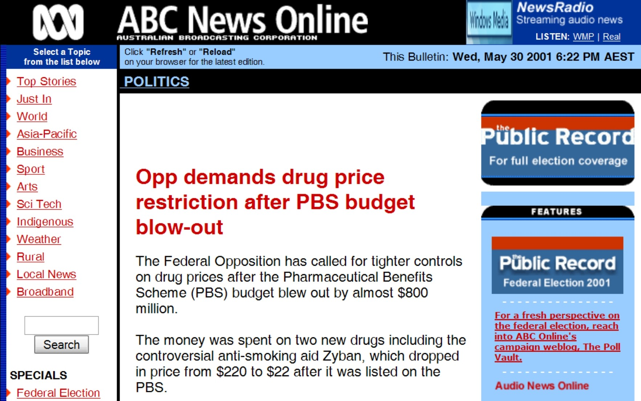
CASE STUDY 2: PBS

Slide 28
CASE STUDY 2: PBS
In 2001: $4.5 billion budget, under-forecasted by $800 million.
Thousands of products. Seasonal demand.
Subject to covert marketing, volatile products, uncontrollable expenditure.
Although monthly data available for 10 years, data are aggregated to annual values, and only the first three years are used in estimating the forecasts.
All forecasts being done with the FORECAST function in MS-Excel!

Slide 29
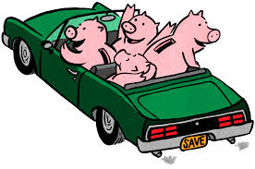
CASE STUDY 3: Car fleet company
Client: One of Australia’s largest car fleet companies
Problem: how to forecast resale value of vehicles? How should this affect leasing and sales policies?
Additional information
They can provide a large amount of data on previous vehicles and their eventual resale values.
The resale values are currently estimated by a group of specialists. They see me as a threat and do not cooperate.

Slide 30
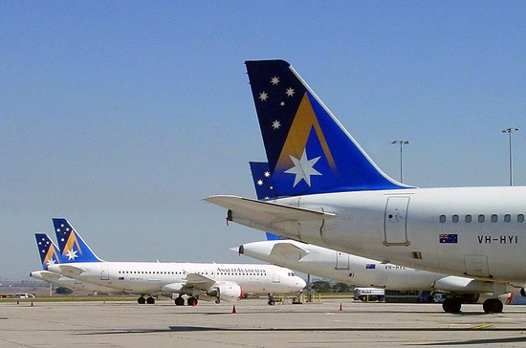
CASE STUDY 4: Airline
Problem: how to forecast passenger traffic on major routes?
Additional information
They can provide a large amount of data on previous routes.
Traffic is affected by school holidays, special events such as the Grand Prix, advertising campaigns, competition behaviour, etc.
They have a highly capable team of people who are able to do most of the computing.

Slide 31
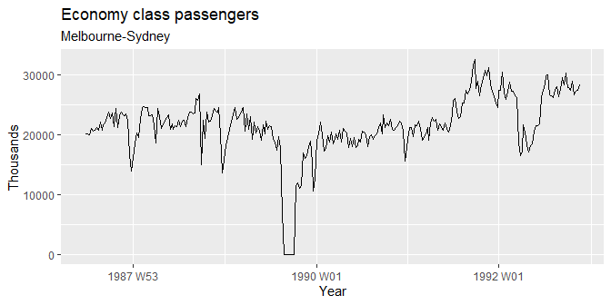
CASE STUDY 4: Airline
Not the real data! Or is it?
Notes:
1989 Australian pilots' dispute
https://en.wikipedia.org/wiki/1989_Australian_pilots

Slide 32
Questions?

